Slide 1
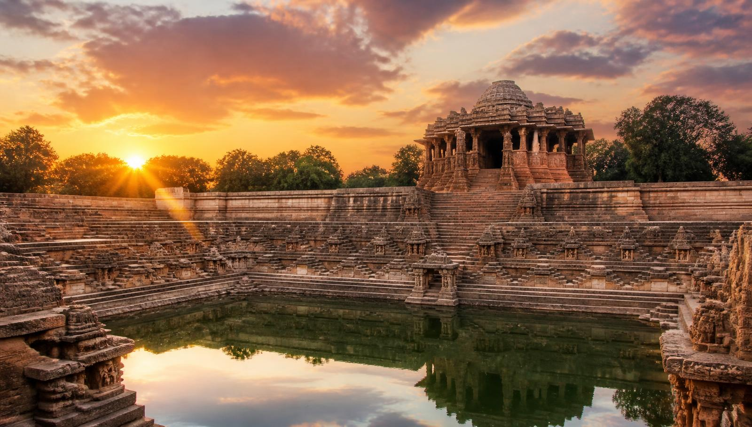
IBM University Engagement — Project Submission
Smart Heritage Conservation Platform
Ahmedabad's Walled City & Modhera Sun Temple
Agentic AI with IBM Granite, IBM BOB & LangFlow | Domain: Tourism & Heritage

Slide 2
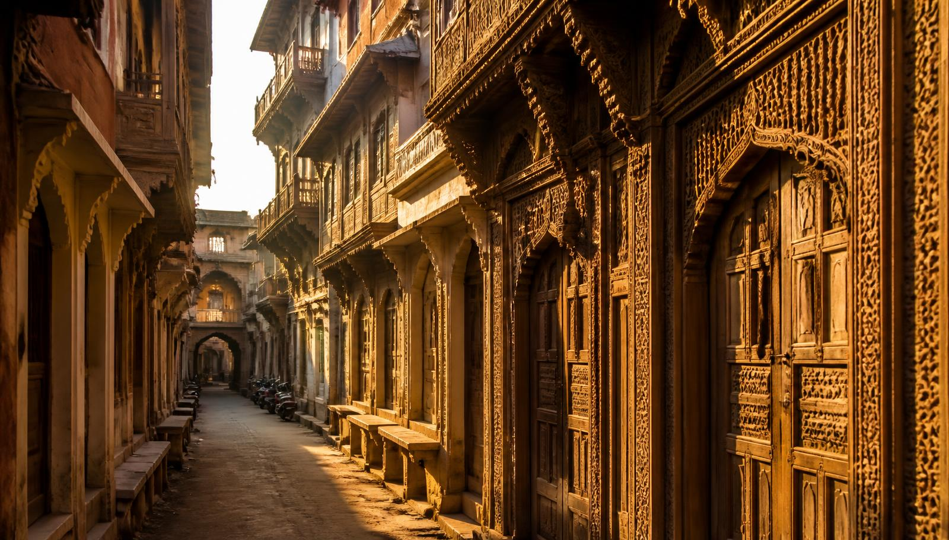
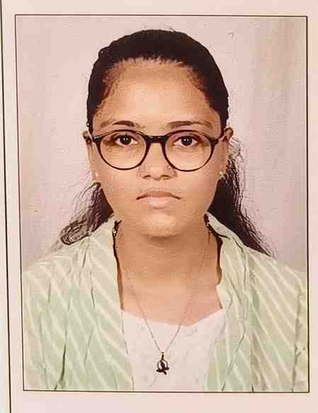
Project Details
Project Title: Smart Heritage Conservation Platform for Ahmedabad's Walled City & Modhera Domain: Tourism & Heritage (Challenge 12)
Student Name | Passport Photo | Email ID | Mobile (WhatsApp)
Panchal Jiya |  | jiyapanchal02954@gmail.com | 9265559166

Slide 3
Problem Statement
The Challenge
Gujarat's UNESCO heritage sites — Ahmedabad's Walled City and the Modhera Sun Temple — face conservation risk from urban encroachment, weathering and unmanaged tourist footfall, while digital storytelling for visitors stays underutilised.
The Objective
Monitor structural health of heritage structures continuously
Manage and forecast visitor flow at peak hours
Deliver immersive, personalised cultural storytelling

Slide 4
Proposed Solution
A multi-agent Agentic AI platform built on LangFlow, IBM BOB and IBM Granite LLM, hosted on IBM Cloud, that turns heritage conservation into a continuous, data-driven and visitor-facing service.
Structural Health Monitoring Agent
Visitor Flow Management Agent
Analyses IoT sensor, drone and image data to detect cracks, erosion and moisture damage; predicts risk scores per structure.
Forecasts footfall, recommends slot booking, alternate routes and crowd caps to reduce physical stress on monuments.
Personalized Heritage Storytelling Agent
Encroachment Detection Agent
Granite-powered RAG narratives in multiple languages, tailored to visitor interest, age and time available.
Compares satellite/CCTV imagery over time to flag illegal construction inside buffer zones.
Conservation Reporting Dashboard Agent
Auto-generates ASI/municipal-ready reports, priority repair lists and budget suggestions.

Slide 5
Technology Used
1
LangFlow
2
IBM Granite LLM
3
IBM BOB
Visual orchestration of the multi-agent conservation workflow
granite-3-2-8b-instruct for reasoning, summarisation & storytelling
Agent builder and orchestration layer for autonomous task execution
4
IBM Cloud
5
RAG + Vector DB
6
IoT / Vision Inputs
Secure, scalable hosting for agents, APIs and data pipelines
FAISS/Chroma over ASI records, heritage archives & inspection logs
Crack sensors, drone imagery and CCTV feeds for site telemetry

Slide 6
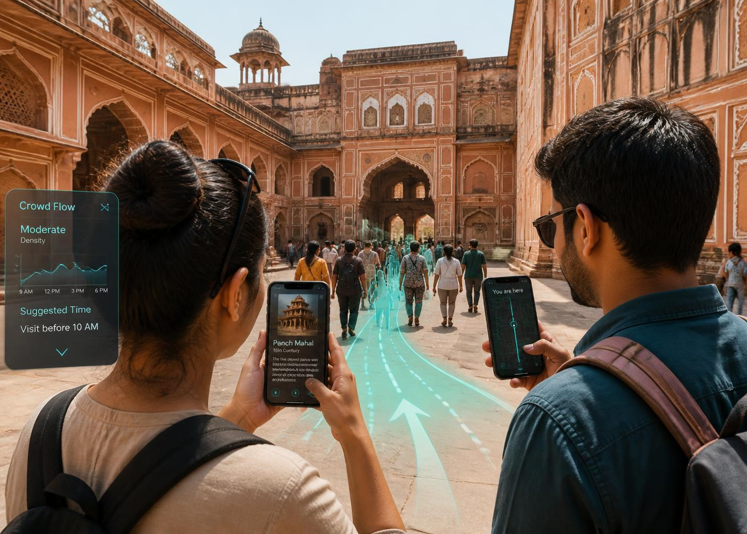
LangFlow Components Used
Chat Input — visitor or officer query (text / voice / image)
IBM watsonx AI Agent — routes the request to the right agent
IBM Granite Model — granite-3-2-8b-instruct for reasoning, narration and report drafting
File / Data Component — ASI logs, sensor CSVs, site imagery
Vector Store (Chroma) + Embeddings — RAG retrieval over heritage documentation
Prompt Template — role prompts for each of the five agents
Chat Output — narration, risk alert, crowd advisory or report

Slide 7
LangFlow Workflow
Chat Input
→
Router Agent
→
Granite LLM
→
Tool / RAG
→
Chat Output
Flow: user query → agent router → Granite reasoning → RAG / sensor tools → grounded response back to visitor or conservation officer.

Slide 8
Architecture Blueprint
Data Sources
IoT crack & humidity sensors • Drone / satellite imagery • CCTV footfall • ASI heritage archives
▼
Ingestion & Storage (IBM Cloud)
Object Storage • Time-series DB • Embeddings → Vector DB (Chroma/FAISS)
▼
Agentic Layer — LangFlow + IBM BOB + Granite
Structural Health • Visitor Flow • Storytelling • Encroachment • Reporting agents
▼
Experience Layer
Visitor mobile/AR app • Conservation officer dashboard • Automated ASI reports & alerts

Slide 9
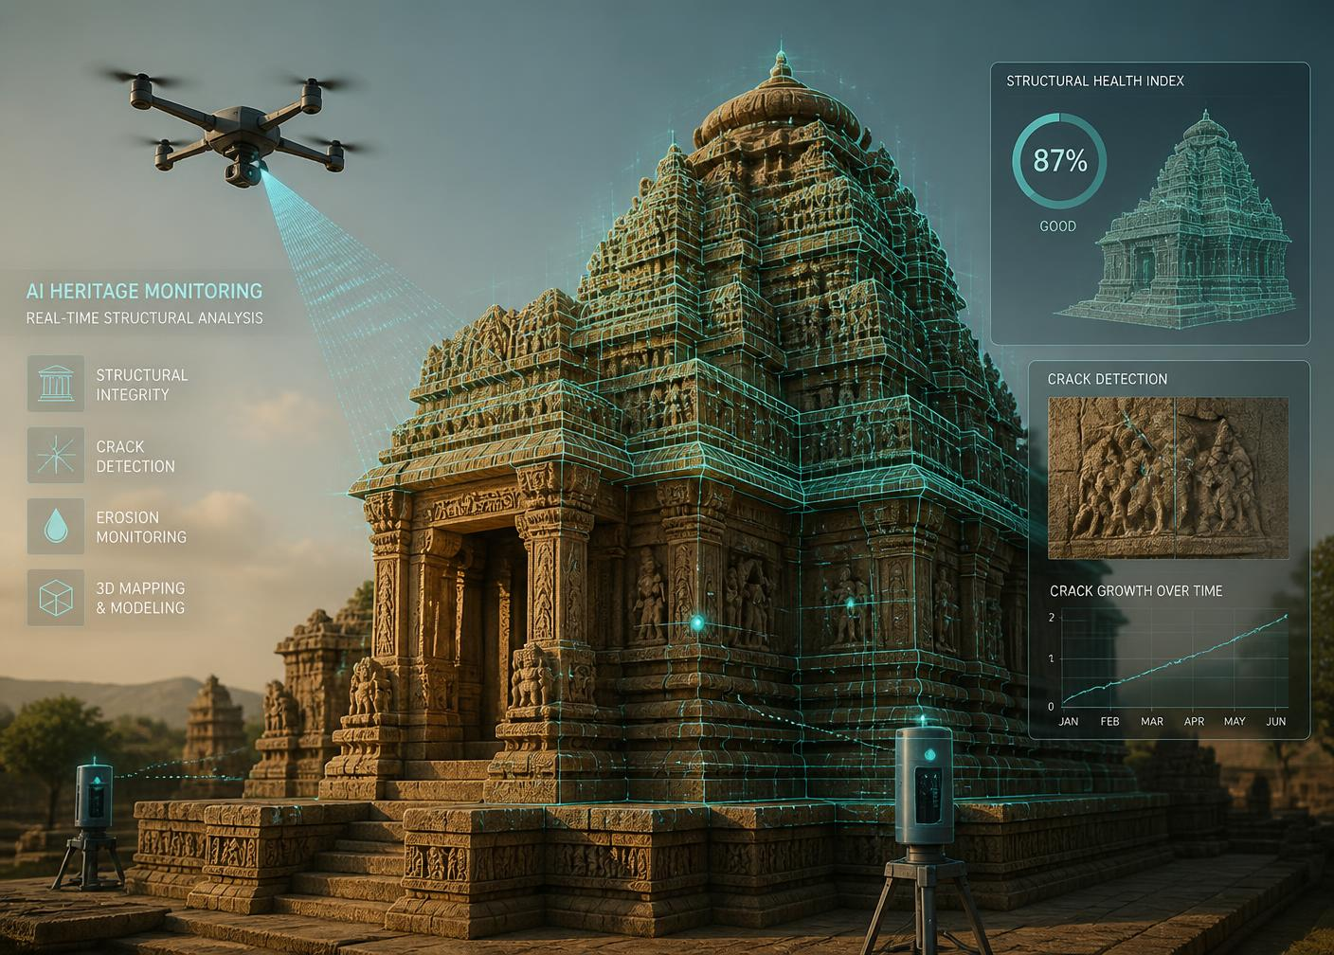
Role of Agentic AI in the Solution
Autonomy — agents run scheduled inspections and raise alerts without being prompted.
Specialisation — five agents each own one conservation responsibility, then collaborate.
Context awareness — decisions factor in monsoon season, festival crowds and monument age.
Tool use — agents call sensor APIs, image models, ticketing systems and report generators.
Continuous adaptation — risk scores and crowd advisories update in real time.
Human-in-the-loop — every conservation action is proposed to ASI officers for approval.

Slide 10
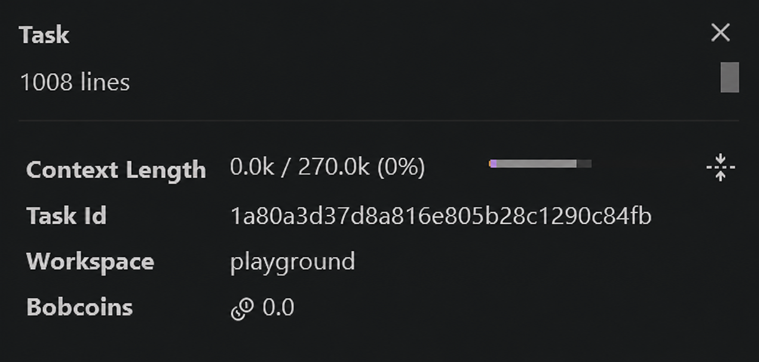
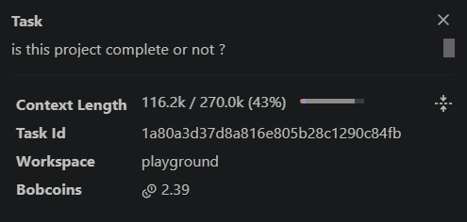
Token Usage
Total tokens used: 116200
[ screenshot ]
[ screenshot ]
Before the Prompt
After the Prompt

Slide 11
Novelty and Uniqueness
Conservation + Tourism in one loop
Predictive, not reactive
1
Crowd data feeds structural risk; risk caps crowd — no existing platform closes this loop.
2
Granite forecasts deterioration before visible damage, prioritising repair budgets.
Hyper-local storytelling
Encroachment early warning
3
Pol-level, multilingual narratives grounded in verified ASI archives via RAG.
4
Time-series satellite diffing turns buffer-zone violations into same-week alerts.
Report automation
Enterprise-grade & governed
5
Officer-ready conservation reports generated in minutes instead of weeks.
6
IBM BOB + Granite on IBM Cloud with auditability and data governance.

Slide 12
GitHub Repository
Repo URL:
https://github.com/jiya-py11/Smart--Heritage-Platform.git

Slide 13
Future Scope
AR / VR Time Travel
Digital Twin of Every Monument
Reconstruct monuments to their original state and let visitors walk through the 15th-century Walled City in AR.
A live 3D twin updated by drone scans, enabling simulation of monsoon and seismic stress.
Statewide Heritage Network
Citizen Reporting & Voice Access
Extend from Ahmedabad and Modhera to Rani ki Vav, Champaner and Dholavira on one dashboard.
Multilingual voice agent plus crowd-sourced damage reports from residents and guides.

Slide 14
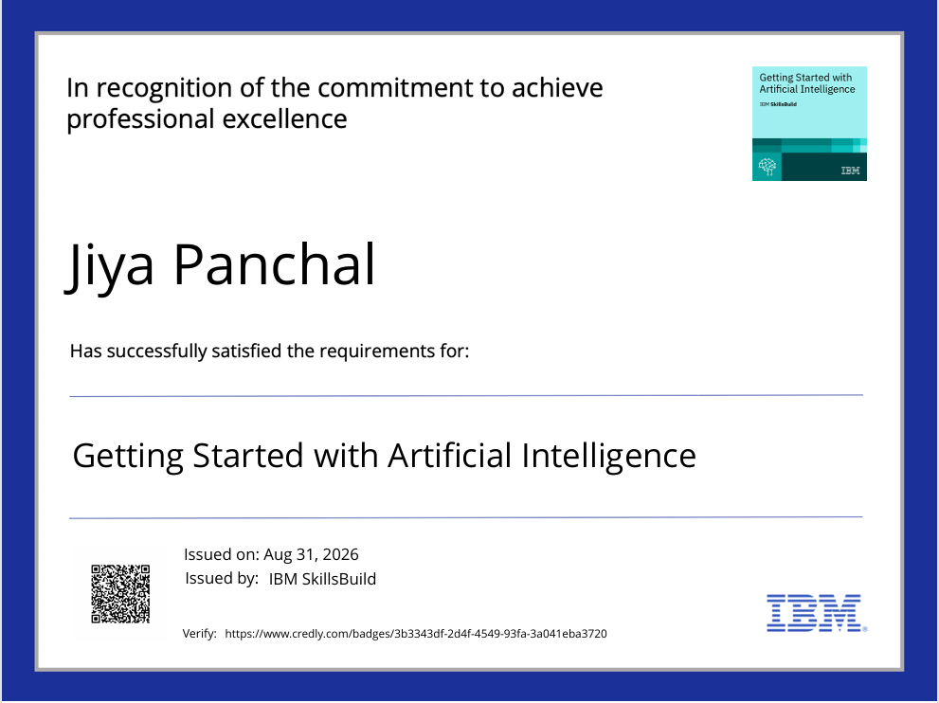
Certificates Earned
Add your Credly certificate here

Slide 15
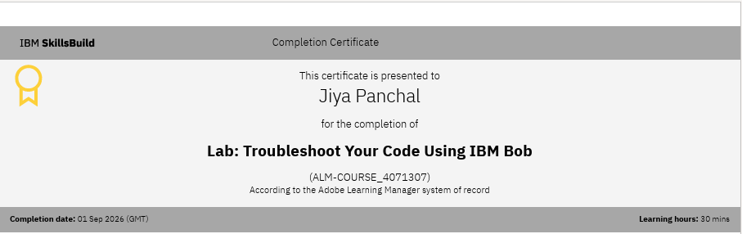
Certificates Earned
Add your IBM BOB certificate here

Slide 16
Thank You
Preserving Gujarat's heritage with Agentic AI — IBM Granite • IBM BOB • LangFlow • IBM Cloud

